Slide 1


Bishal Bhattarai Anup Upreti Anup Timsina Arbin Sapkota Chirag Pandey

Slide 2


web development ????

Slide 3
A webpage is a document commonly written in HTML (Hypertext Markup Language) that is accessible through the Internet or other networks using an Internet browser. A web page is accessed by entering a URL address and may contain text, graphics, and hyperlinks to other web pages and files.

Slide 4
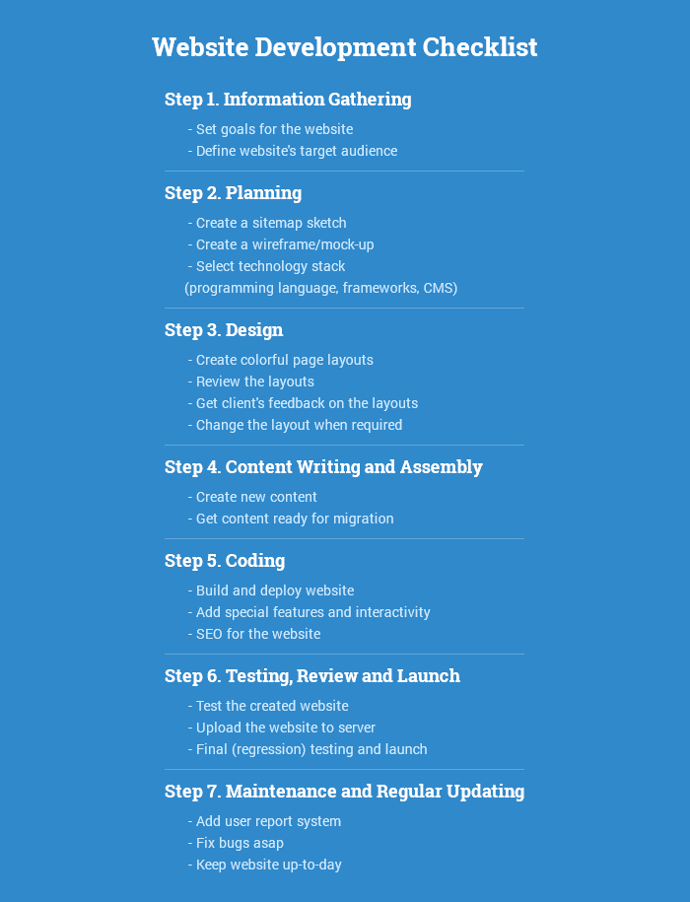
Web page development process

Slide 5
Steps: Step 1. Gathering Information: Purpose, Main Goals, and Target Audience This stage, the stage of discovering and researching, determines how the subsequent steps will look like. The most important task at this point is to get a clear understanding of your future website purposes, the main goals you wish to get, and the target audience you want to attract to your site.

Slide 6
step 2. Planning: Sitemap and Wireframe Creation At this stage of the website development cycle, the developer creates the data that allow a customer to judge how the entire site will look like.
Based on the information that was gathered together in the previous phase, the sitemap is created.

Slide 7
Step 3. Design: Page Layouts, Review, and Approval Cycle
During the design phase, your website takes shape. All the visual content, such as images, photos, and videos is created at this step. Once again, all the info that was gathered through the first phase is crucial. The customer and target audience must be kept in mind while you work on a design.

Slide 8
Step 4. Content Writing and Assembly
Content writing and compiling usually overlaps with other stages of website creation, and its role can’t be underestimated. At this step, it is necessary to put in writing the very essence you’d like to communicate to the audience of your website and add calls-to-action.

Slide 9
Step 5. Coding
At this step, you can finally start creating the website itself. Graphic elements that have been designed during the previous stages should be used to create an actual website. Usually, the home page is created first, and then all sub-pages are added, according to the website hierarchy that was previously created in the form of a sitemap.

Slide 10
Step 6. Testing, Review, and Launch
Testing is probably the most routine part of a process. Every single link should be tested to make sure that there are no broken among them. You should check every form, every script, run a spell-checking software to find possible typos. Use code validators to check if your code follows the current web standards. Valid code is necessary, for example, if cross-browser compatibility is crucial for you.

Slide 11
Step 7. Maintenance: Opinion Monitoring and Regular Updating
What’s important to remember is that a website is more of a service than a product. It’s not enough to “deliver” a website to a user. You should also make sure that everything works fine, and everybody is satisfied and always be prepared to make changes in another case.

Slide 12
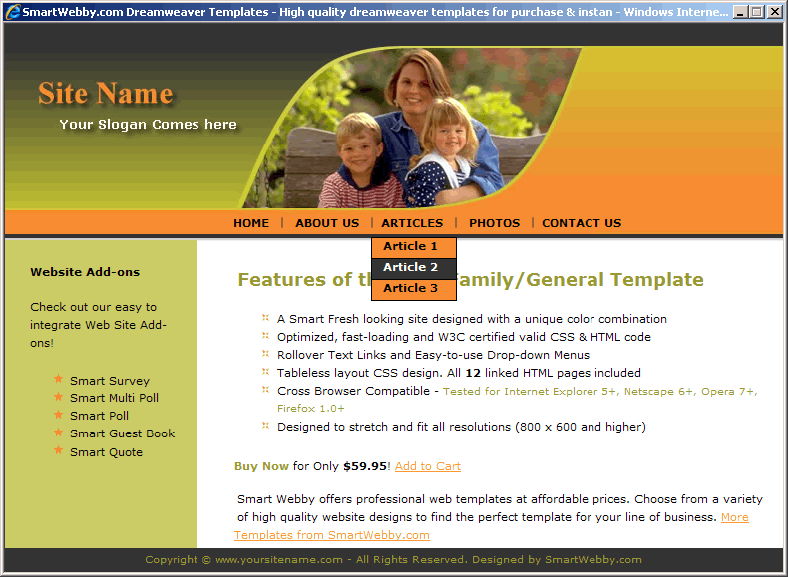

Slide 13

Question ????

Slide 14







